Slide 1

Consumption Meter
Consumption Meter with Atmega328 Bruno Esteves Beatriz Lopes Mara Reis

Slide 2
The basis
The project use 1 ACS712 current sensor to read the current and the ADC to read the voltage. The ACS712 send analog signal to the ADC To read the voltage we use the voltage divider

Slide 3
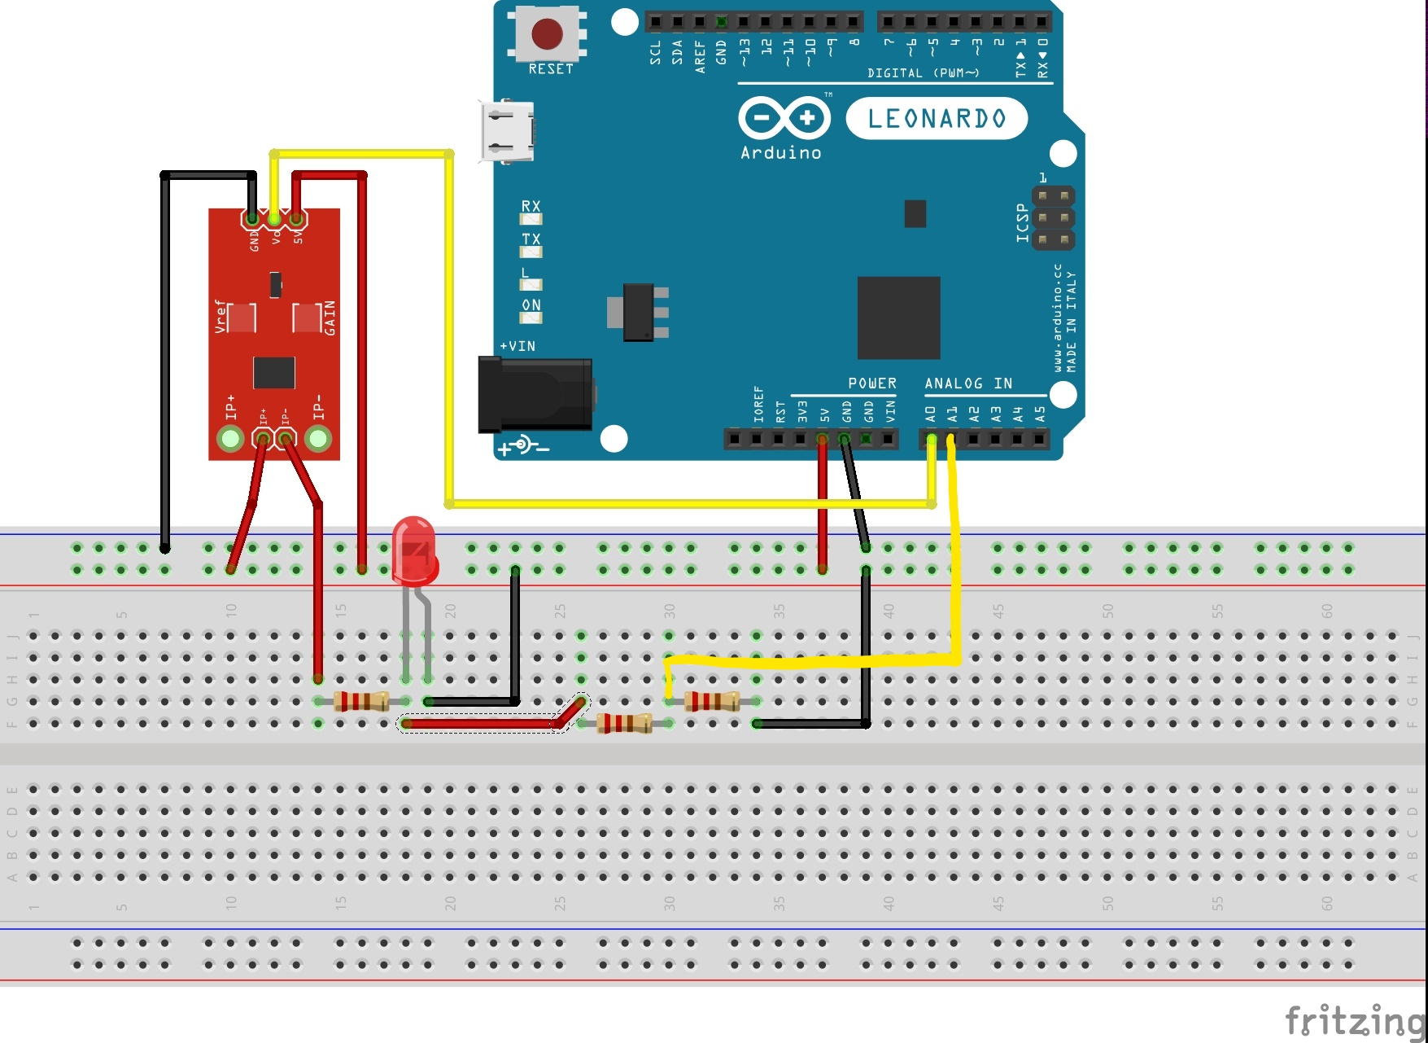
Diagram

Slide 4
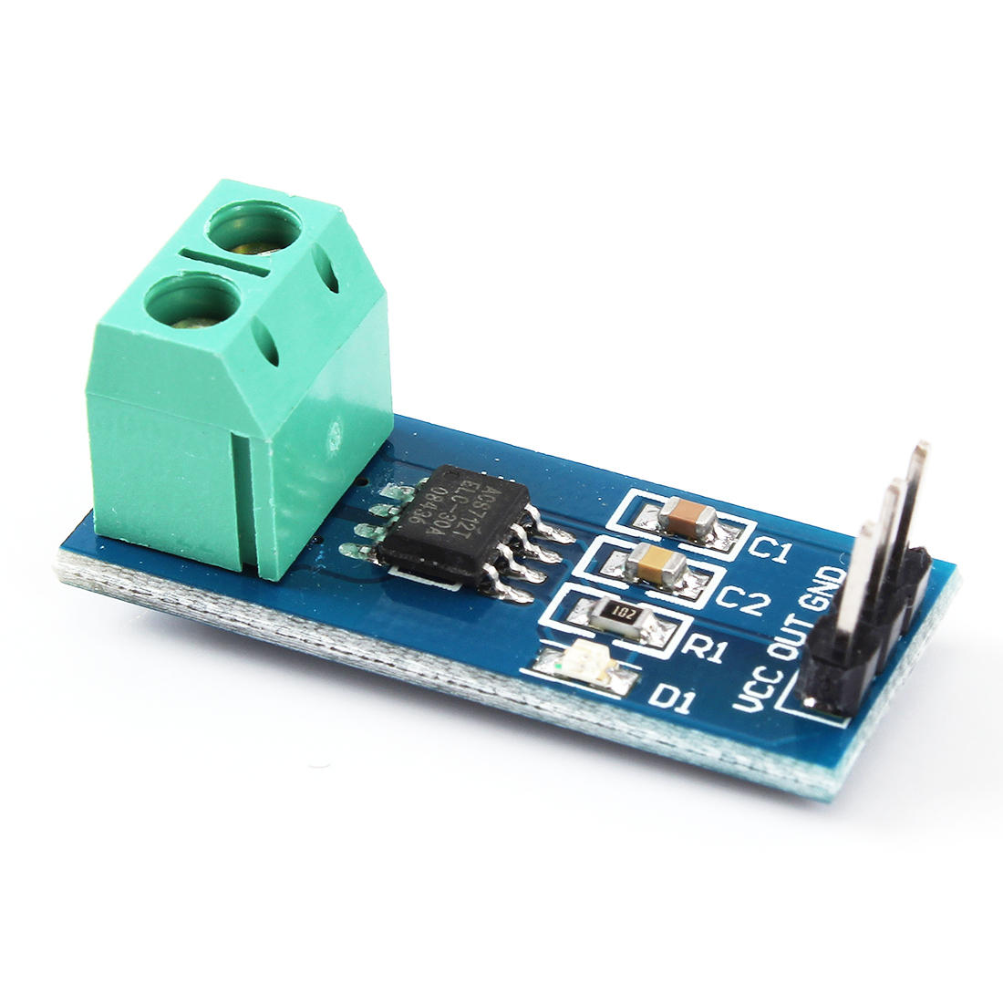
The ACS712
The ACS are a sensor that use the hall effect to measure the current The Value are send to the A0 Analog pin of the Atmega

Slide 5
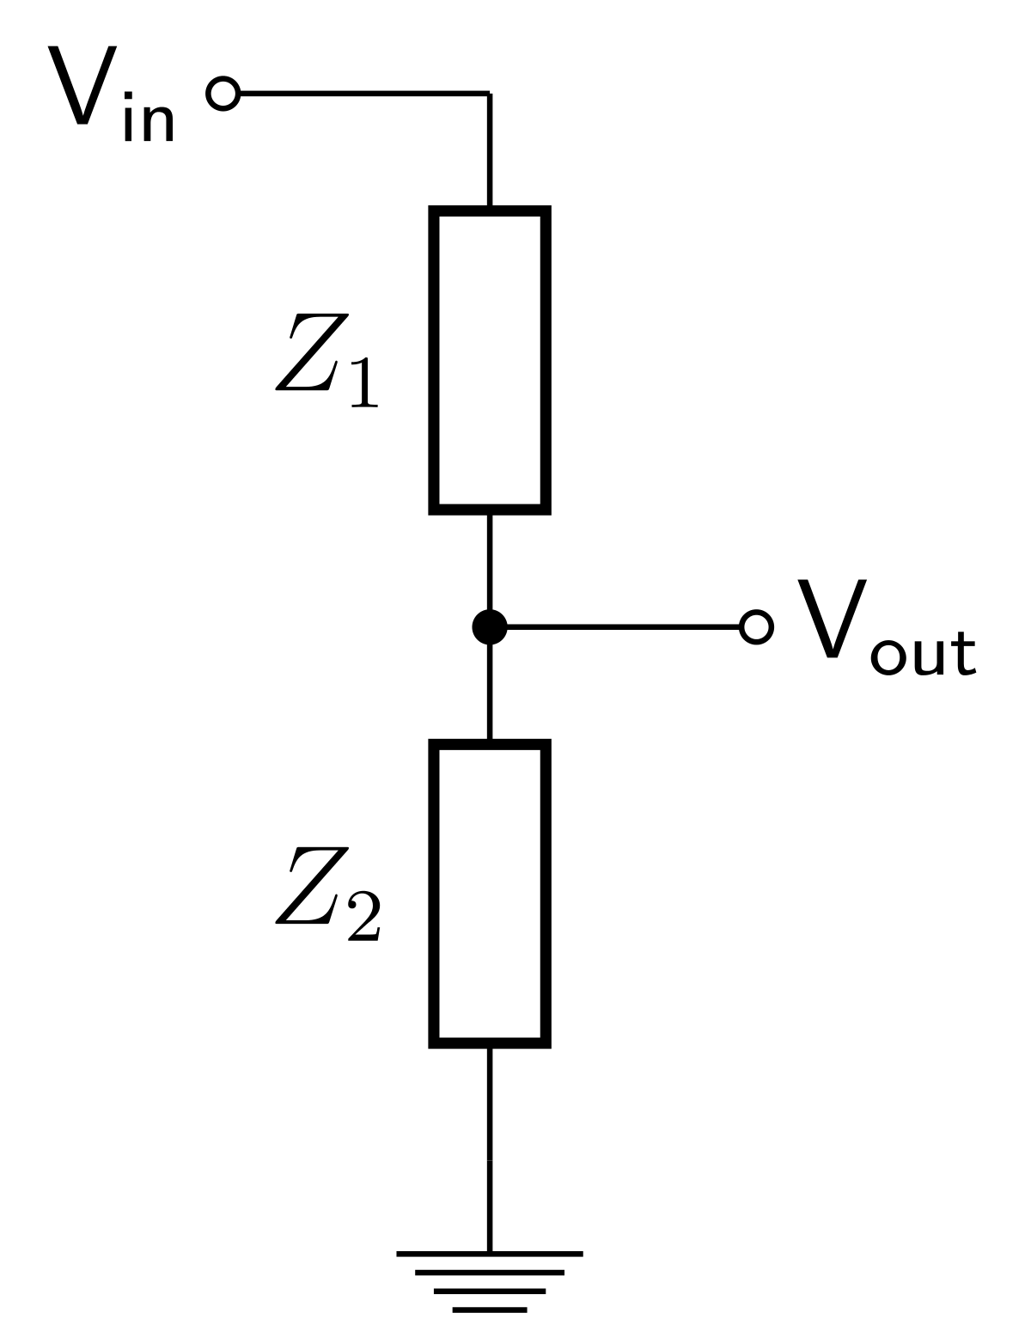
Measuring the voltage
Due to limitation of the microcontroller, we only can use one chanel of the ADC at time, we need to switch to one chanel to another The Voltage is send to the ADC (Analog pin A1)using a tension divider, with 2 resistor

Slide 6
The data
To save the data we use the UART
With putty we can save the data to a .csv file

